Slide 1

Using De Novo Ligand to Discover Protein Inhibitors to Treat Anaplastic Thyroid Cancer
By: Shahd Ismail and Dr. Anderson

Slide 2
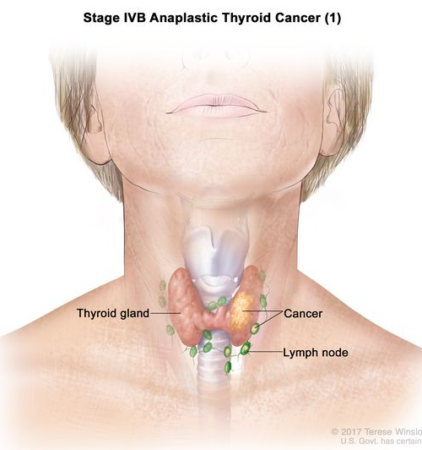

Anaplastic Thyroid Cancer
Fastest growing and most hostile of all cancers
Undifferentiated Thyroid Cancer
Cause of it is unknown
Rare, found in less than 2% of patients
Commonly in those over 60 years of age
Notes:
Known as Undifferentiated Thyroid Cancer because the cells doesn’t behave or look like normal thyroid cells.
Cause of Thyroid Cancer is unknown but, in some cases, it can arise in differentiated thyroid cancers such as papillary or follicular thyroid cancers. ( Well-differentiated thyroid cancers degenerates and turn into anaplastic thyroid cancer)
Picture( Cancer is found in the thyroid and the tumor can be any size. Cancer spreads out throughout and nearby the lymph nodes)
Once anaplastic cancer grows quick which can happen in weeks, this can cause symptoms like difficult swallowing, food/pills getting stuck when they swallow, sometimes difficulty breathing when laid flat. Patients with this type of cancer feel like they have a rock-hard mass.
https://www.thyroid.org/anaplastic-thyroid-cancer/#:~:text=Anaplastic%20thyroid%20cancer%20is%20the,the%20age%20of%2060%20years.

Slide 3
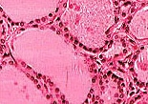
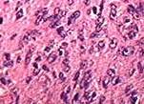
Normal Thyroid Tissue
Anaplastic Thyroid Tissue
VS
Notes:
Anaplastic Thyroid Tissue; Tumor cells starts growing in solid clusters, however some tumors are in the shape of spindles
https://columbiasurgery.org/conditions-and-treatments/anaplastic-thyroid-cancer

Slide 4
Medication | Protein Target
Fosbretabulin | β-tubulin with K_{d} of 0.4 μM in a cell-free assay
Bortezomib | CT-L subunit of the proteasome C-L and T-L subunits with lower affinity
TNF-Related Apoptosis Induced Ligand(TRAIL | recruits pro-caspase-8 which leads to its activation
Notes:
I was able to research the drugs used to treat Anaplastic Thyroid Cancer and figured out the protein target the medications were able to bind to. And use this to later design molecules that also bind to the same proteins but in higher binding affinity and low toxicity potential

Slide 5
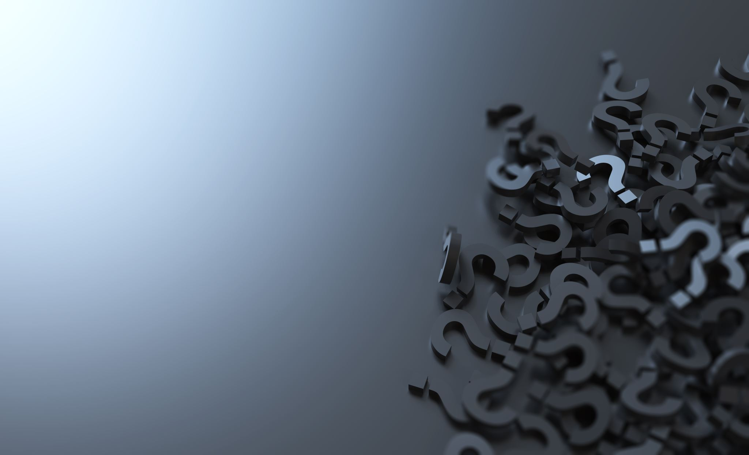
Research Question
The purpose of my research project is to use DeNovo Ligand to design and determine which compounds would have a higher binding affinity and low toxicity potential to target the proteins. The compounds that were determined could be a solution to cure Anaplastic Thyroid Cancer.

Slide 6
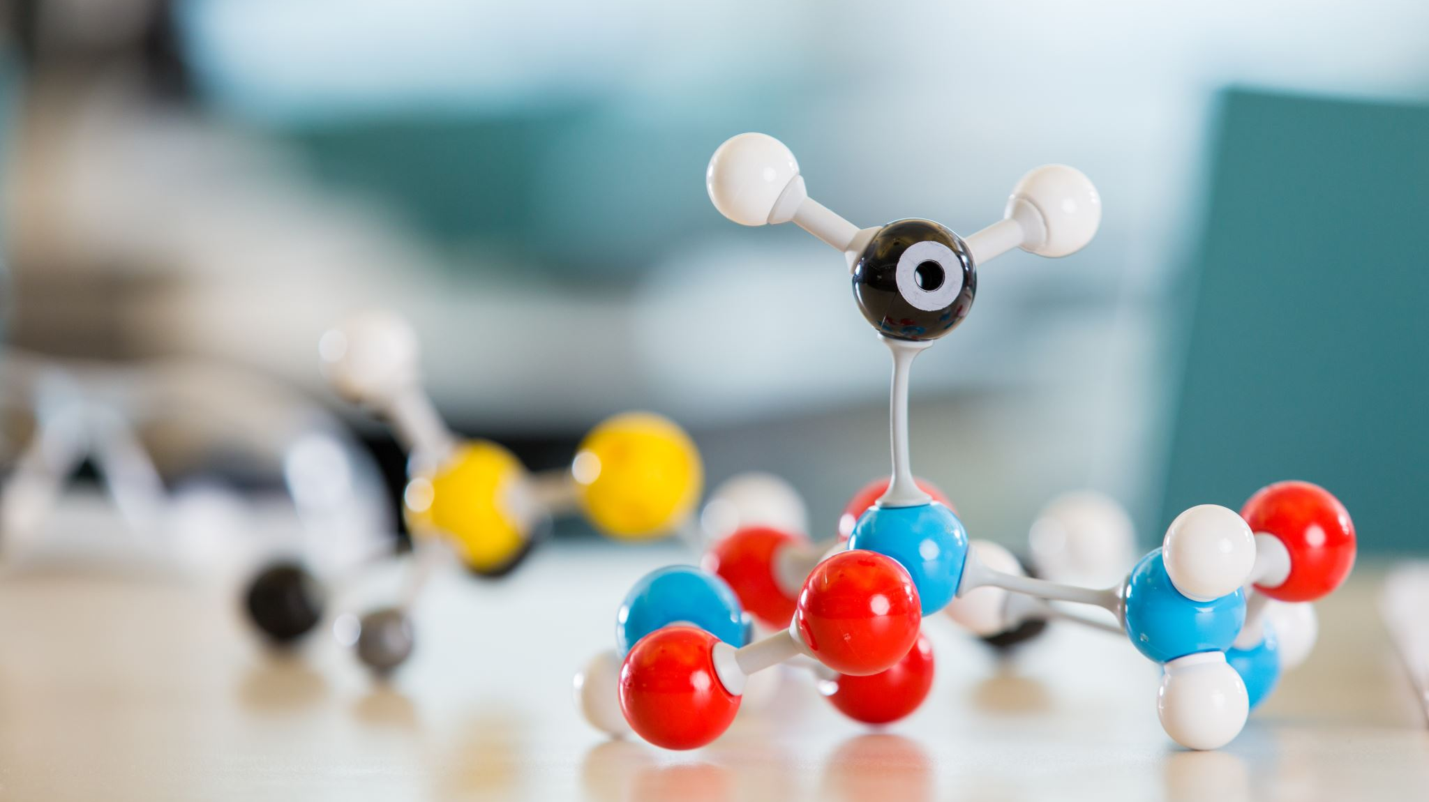
Methods
Use DeNovo Drug Design to run my ligand 11 times
Estimate the Kd Values of each ligand using AutoDock Vina and X-Score
Using ADMET to Predict if my compounds were absorbed across the human intestine and likely carcinogenic.
In ADMET, upload file having all compounds and determining which were the “successful compounds”
Making 2D images of the compounds
Using Protein Plus to make 3D images of the designed ligands bounded to the protein target
Notes:
11 runs helps with generating a better sampling
With the Help of professor Anderson we were able to determine the Kd Values
Drug compound should be absorbed across the instistine so that it can taken by mouth , drug compound should not be carcinogenic(cancer causing) to humans
Successful compounds are predicted to be taken by the moth and aren’t carcinogenic

Slide 7

Results
Runs | Affinity(nm)
Run1 | 2870nM
run2 | 780nM
Run3 | 160nM
Run4 | 1360nM
Run5 | 610nM
Run6 | 610nM
Run7 | 20nM
Run8 | 10nM
Run9 | 4330nM
Run10 | 790nM
Run11 | 260nM

Slide 8
Description of Results
8 out of 11 of my ligands were binded with higher affinity to my target protein
8 of my ligands had a Kd Value less than 1000nM
Run 1, Run 4, and Run 9 were not good binders
Ligand 1,2,3,4,6,7,8,10 have a category of 1 for the Human Intestinal Absorption (HIA).
All 11 ligands had a category of 0 for Ames Mutagenicity
1 for HIA and 0 for Ames mutagenicity are successful compounds and could become a drug
Notes:
Smaller the Kd value the stronger the interaction between the ligand and the protein
kD less than 1000nM is very good ,
0 for Ames meant they aren’t carcinogenic
1 for HIA meant they can be absorbed from the gastrointestinal tract into the general circulation = can be taken by the mouth

Slide 9

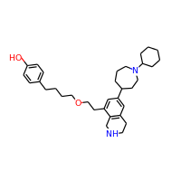
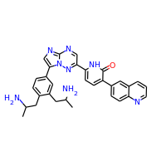
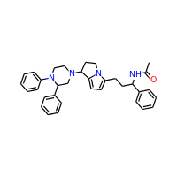
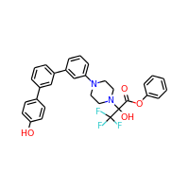
Images of Ligands Part 1
Ligand 4
Ligand 2
Ligand 1
Ligand 3

Slide 10
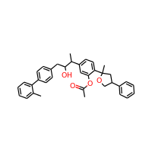
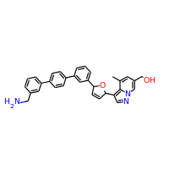
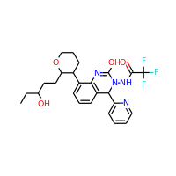
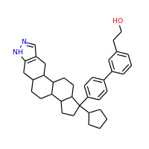
Images of Ligands Part 2
Ligand 8
Ligand 7
Ligand 6
Ligand 10

Slide 11
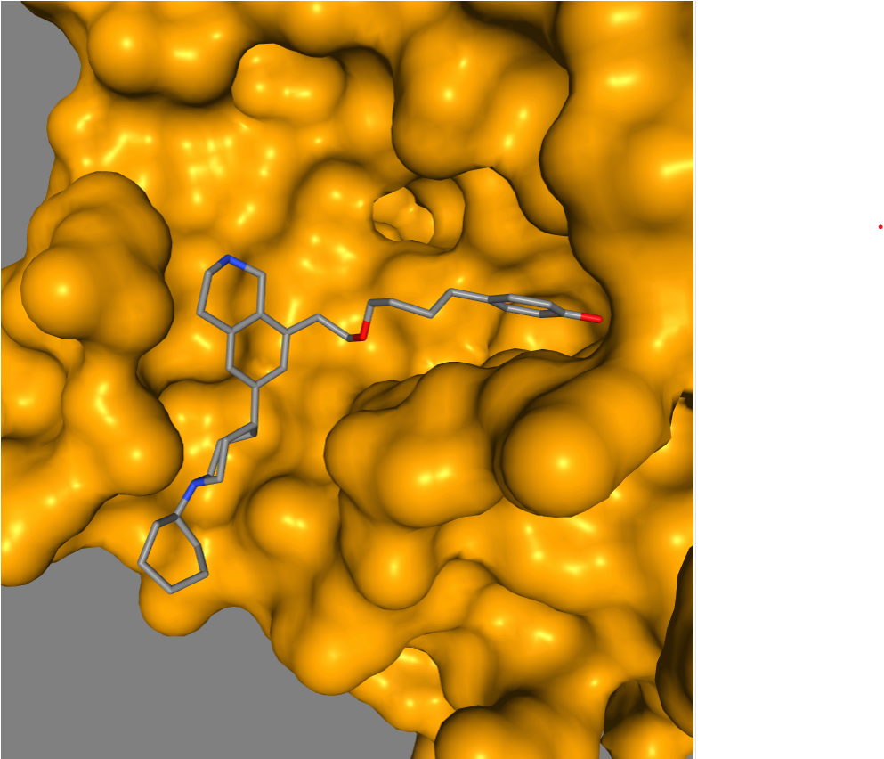
Ligand 2 bound to the receptor

Slide 12
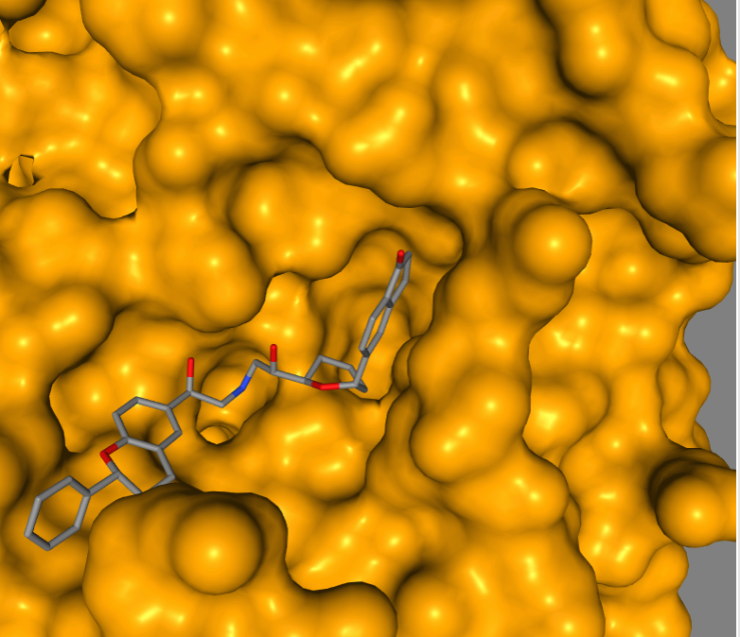
Ligand 3 bound to the receptor

Slide 13
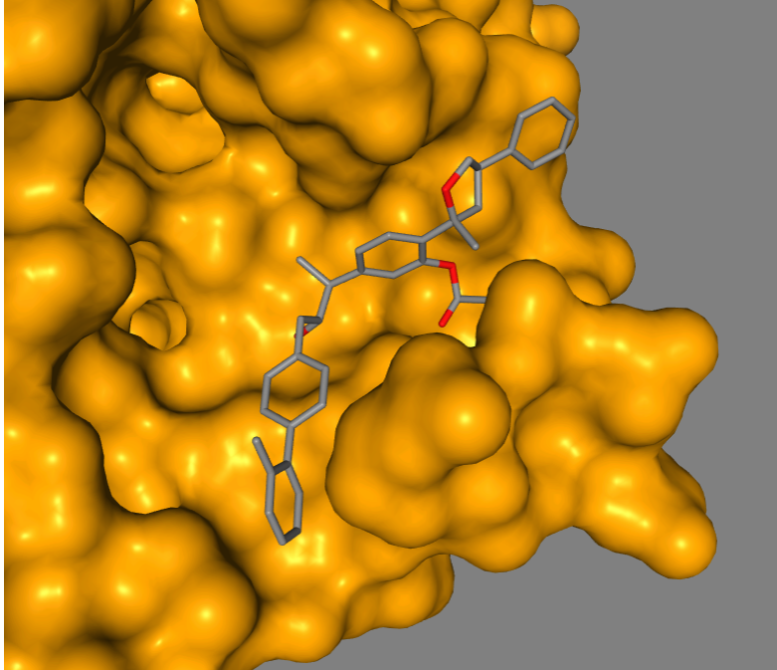
Ligand 6 bound to the receptor

Slide 14
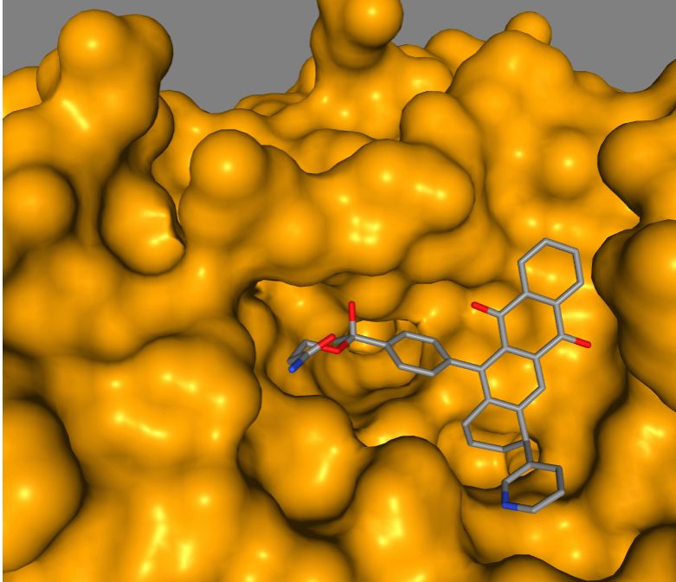
Ligand 7 bound to the receptor

Slide 15
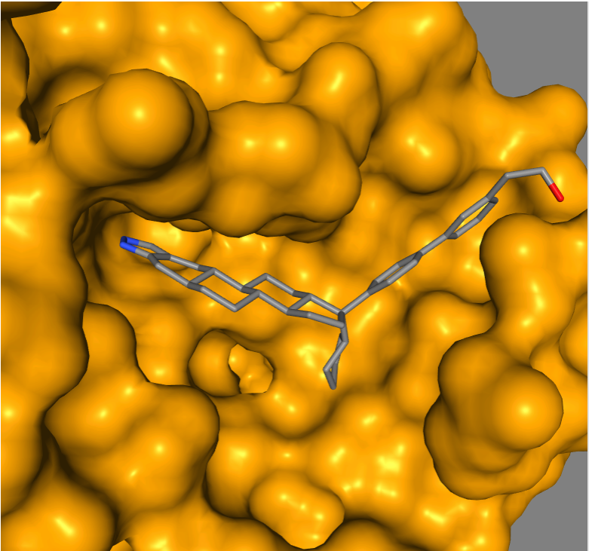
Ligand 8 bound to the receptor

Slide 16
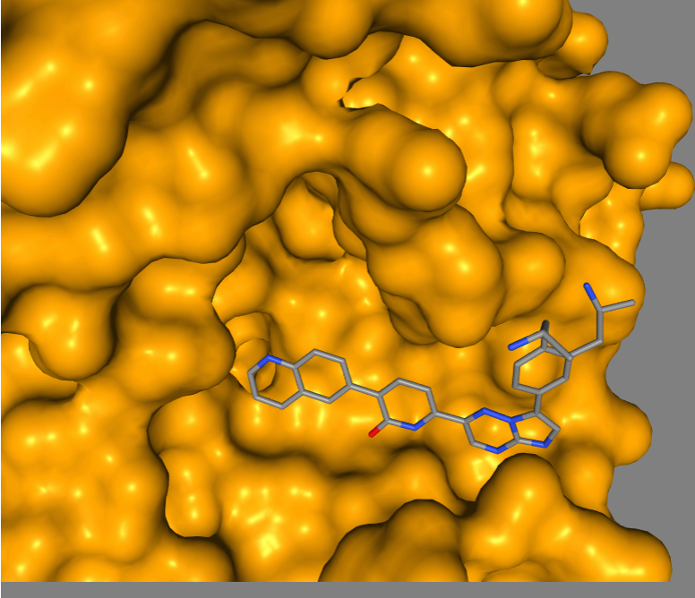
Ligand 10 bound to the receptor

Slide 17
Conclusion
Run 2,3,5,6,7,8,10,11 were great binders since they all had higher affinity with a Kd value below 1000nM. However, ligands 1,4, and 9 had affinity's that were greater then 1000nM making them weak binders. Ligands 2,3,6,7,8 and 10 would inhibit my protein since they can be taken by mouth, aren’t carcinogenic and have higher affinity.

Slide 18
Work Cited
https://www.thyroid.org/anaplastic-thyroid-cancer/#:~:text=Anaplastic%20thyroid%20cancer%20is%20the,the%20age%20of%2060%20years.
https://columbiasurgery.org/conditions-and-treatments/anaplastic-thyroid-cancer

